Slide 1

Martian Surface With The Eyes Of Mars Orbiter Mission (MOM)
Abhishek Gupta (83165)
Introduction to Research
MEFT, Instituto Superior Tecnico

Slide 2


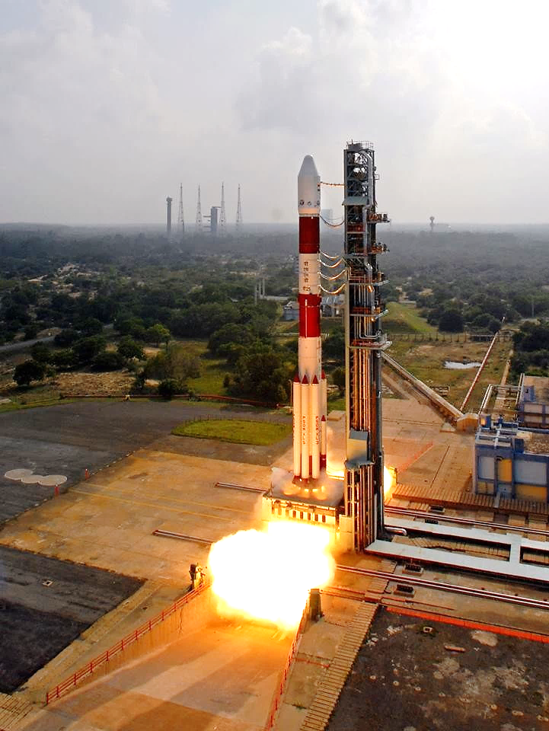
‘Mangalyaan’ in Brief
First Interplanetary Mission of India.
Meaning - ‘Mars-craft’(in Sanskrit)
Duration – 15 months
Budget - 450 cr.
Operator – ISRO
Launch Centre – SDSC
Launch date – 5th Nov. 2013
Orbital Insertion - 24th Sep. 2014
Martian Surface with the eyes of MOM

Slide 3
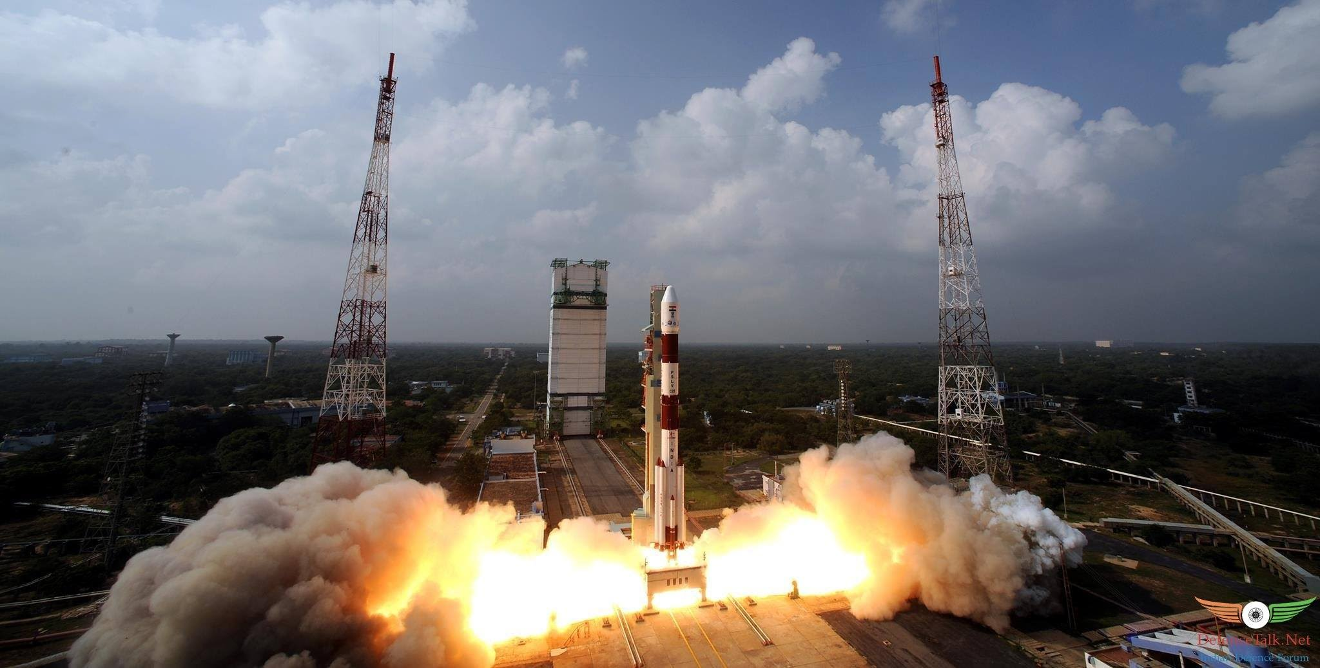
Facts about MOM
PSLV, not GSLV
Trajectory
Budget
Martian Surface with the eyes of MOM

Slide 4


PSLV, not GSLV
Meet my friends, Polar
And Geo,
Success Rate
Reliable
Powerful, but not Reliable
Martian Surface with the eyes of MOM

Slide 5
Martian Surface with the eyes of MOM

Slide 6
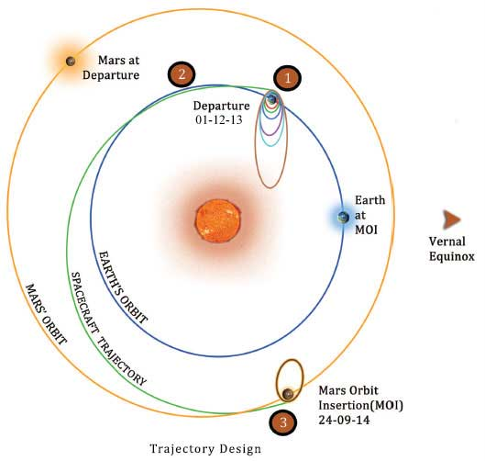
Trajectory
Martian Surface with the eyes of MOM

Slide 7
Objectives
Mission Objectives :
Develop Technologies for Interplanetary Missions
Technical Objectives :
Develop Mars Orbiter capable of Survive and Perform
Scientific Objectives :
Exploration of Martian surface feature and atmosphere
Martian Surface with the eyes of MOM

Slide 8
Space-craft..
Martian Surface with the eyes of MOM

Slide 9
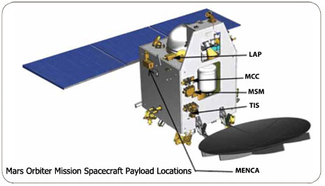
Payloads
MCC
MSM
LAP
MENCA
TIS
Martian Surface with the eyes of MOM

Slide 10
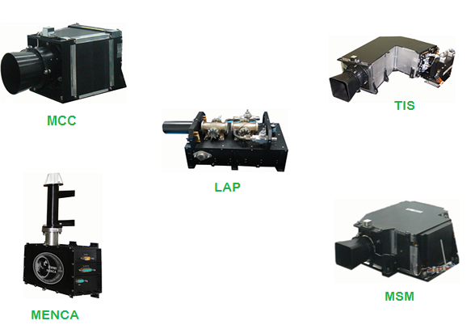
Payloads
Martian Surface with the eyes of MOM

Slide 11
Martian Surface
Martian Surface with the eyes of MOM

Slide 12
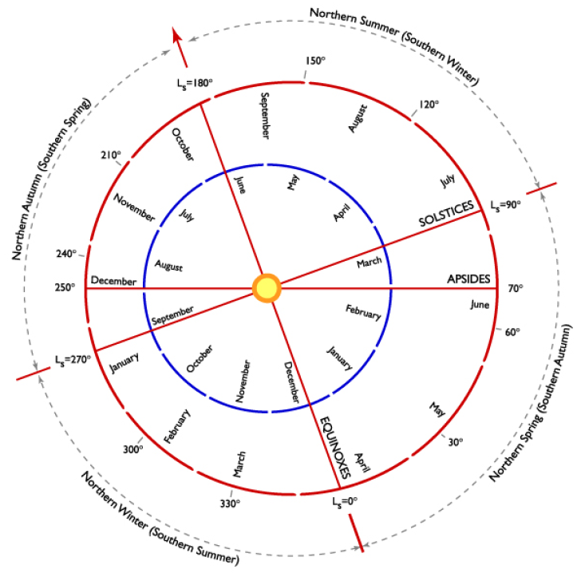
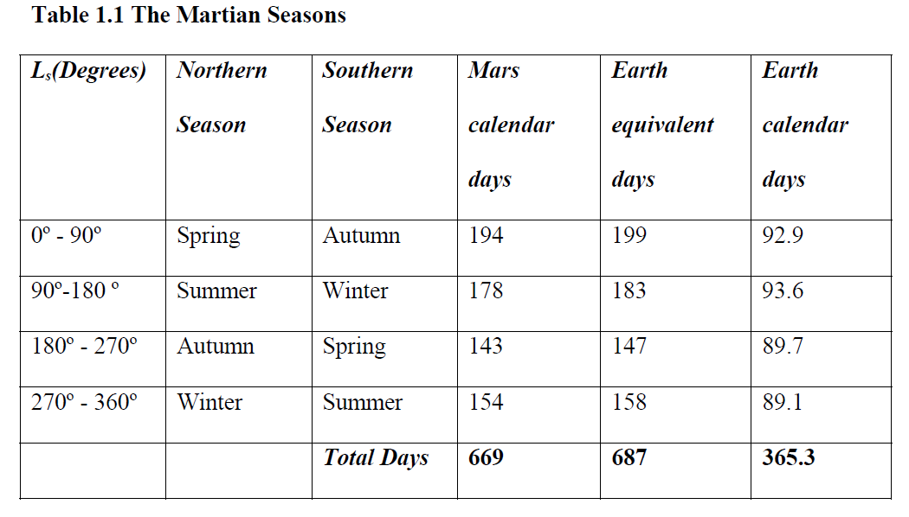
Martian Seasons
Martian Surface with the eyes of MOM

Slide 13
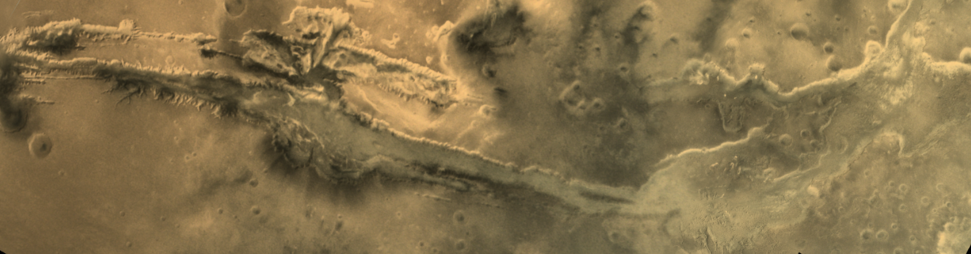
Valles Marineris
Location(4000 km)
Atmosphere
Optical Depth
Martian Surface with the eyes of MOM

Slide 14
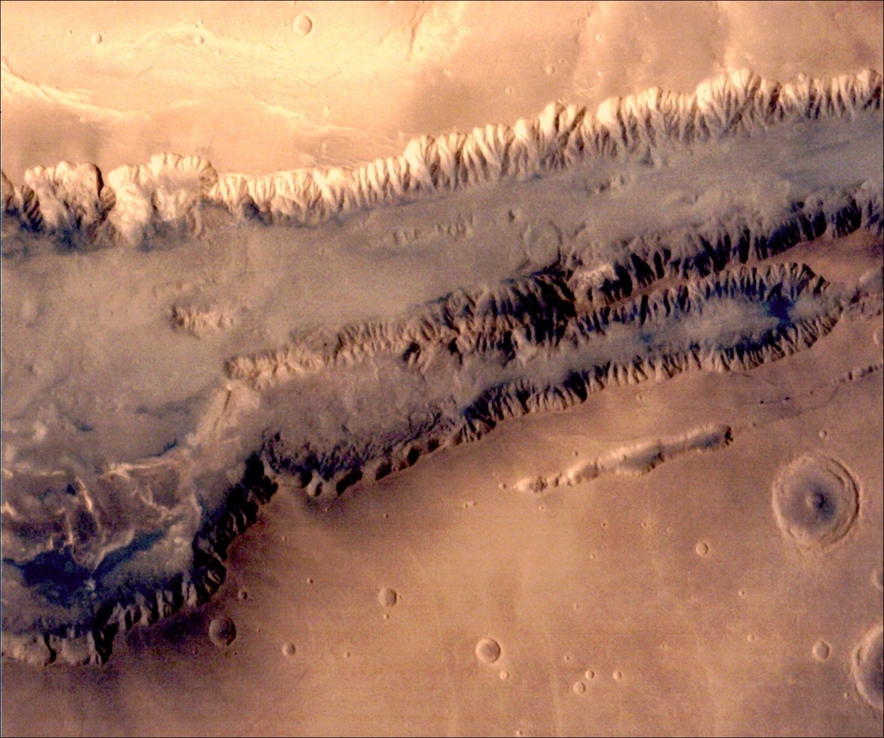
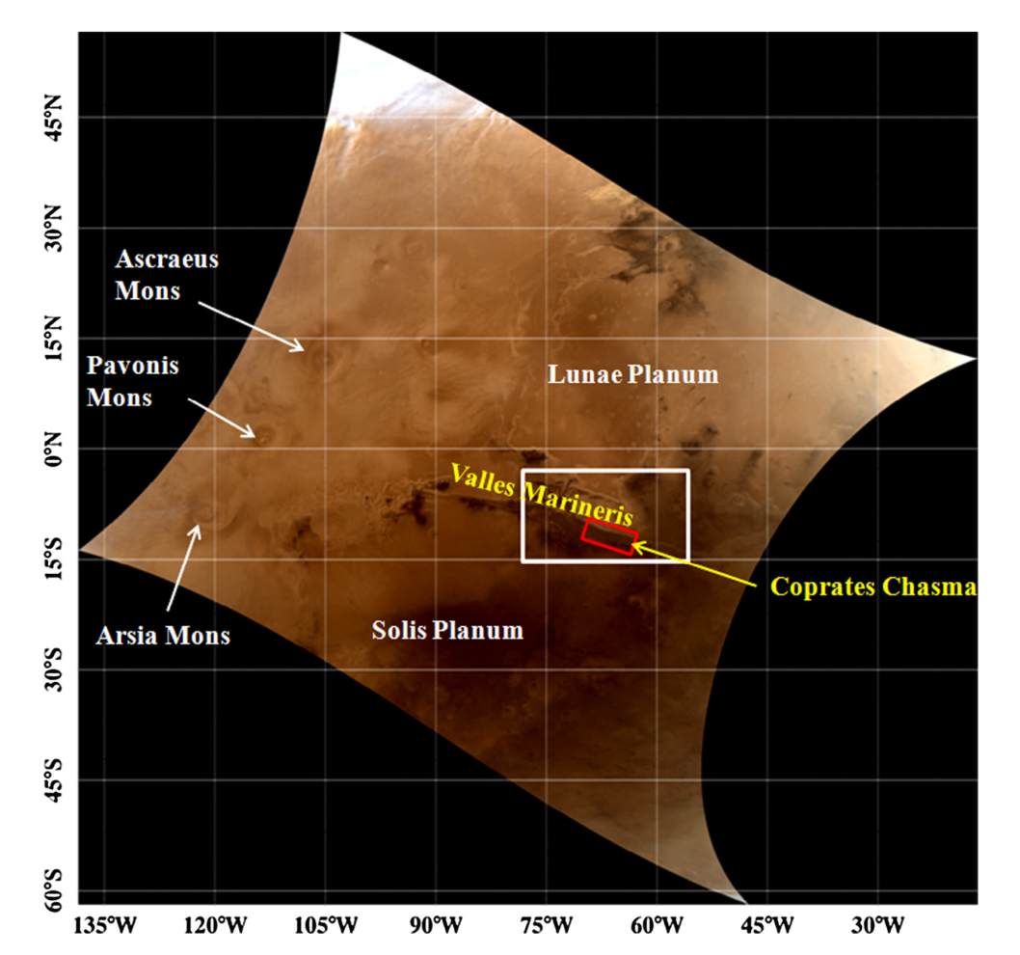
Study Area
N
Coprates Chasma
Melas Chasma

Slide 15
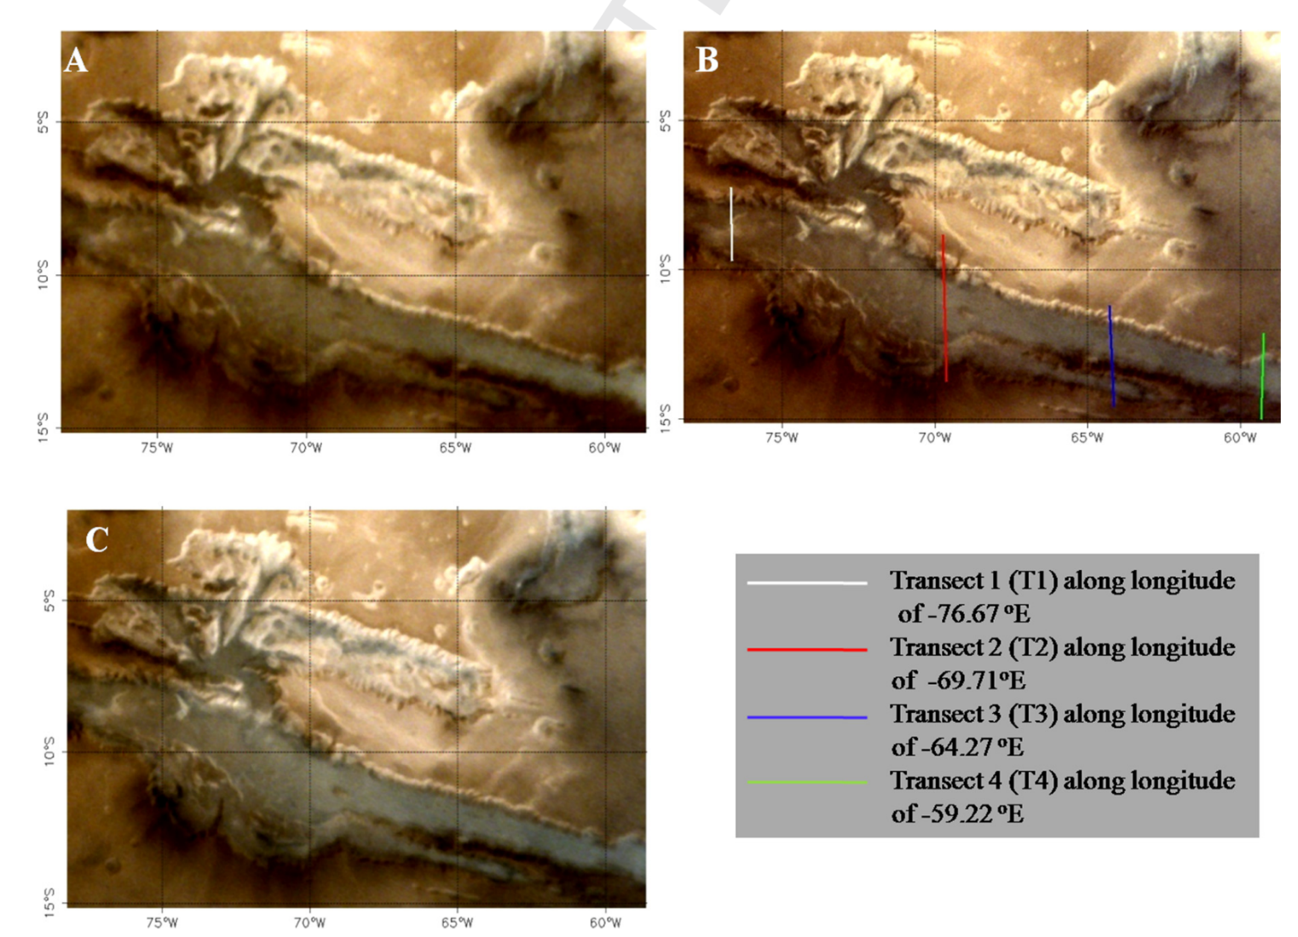
Change in Brightness
T1
T2
T3
T4
28 Oct 2014 (orbit 34, Ls = 222.63, LT = 9:16)
5 Dec 2014 (orbit 49, Ls = 246.59, LT = 9:48)
13 Dec 2014 (orbit 52, Ls = 251.82, LT = 9:48)
Brightness changes due to the dust effect
Martian Surface with the eyes of MOM

Slide 16
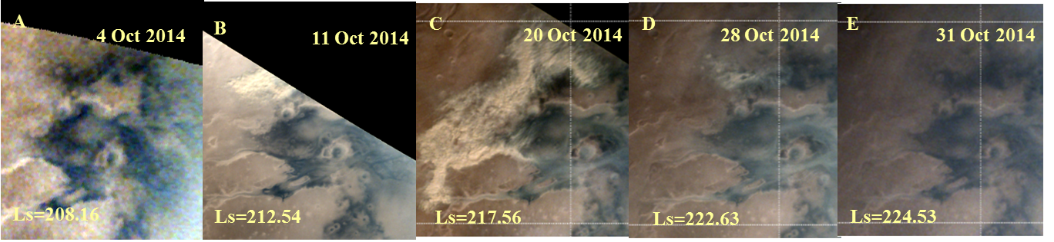
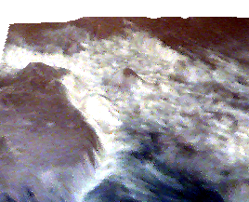
Identification of Dust
Dust cloud activity captured in MCC
Sharnov crater

Slide 17
Identification of Dust
The higher difference describes the dust containing region

Slide 18
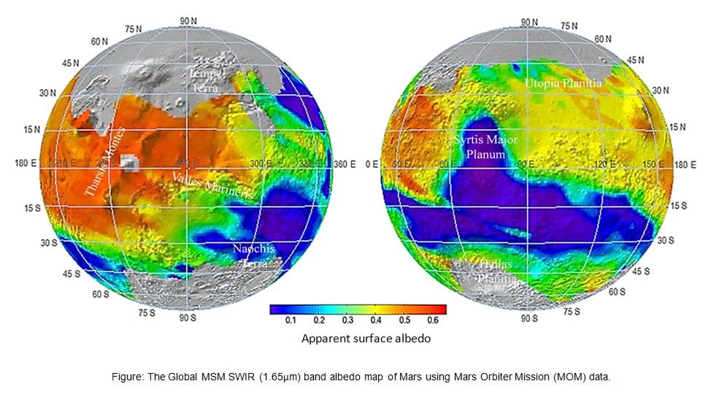
Global SWIR Albedo Map
Fraction of incident solar radiation reflected by the surface.
Wavelength band 1.64-1.66 µm
Spatial resolution ~50 km
Low value – Dark surface (having volcanic rock basalt)
High Value – Covered with Dust.

Slide 19
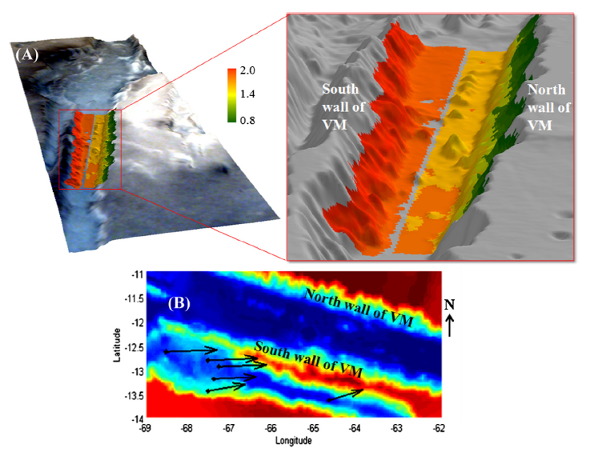
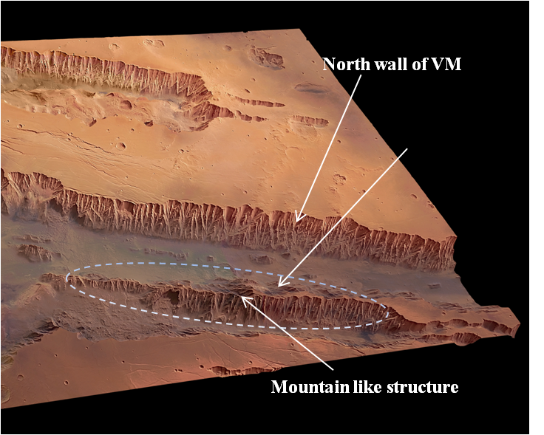
Average modelled wind speed - 3.26 m/s and 8^{O} with respect to east direction.
Atmospheric Optical Depth

Slide 20
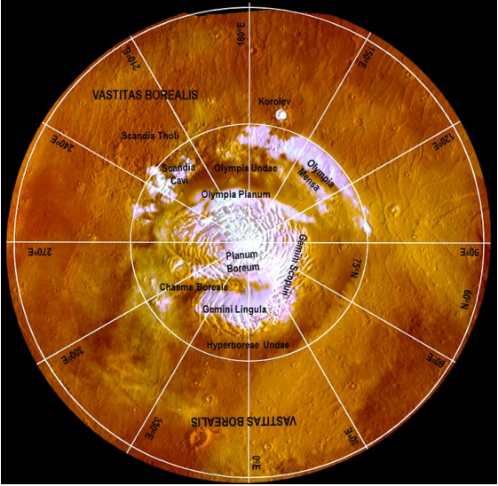
Polar Ice Cap
Ls=0º is the start of northern spring
Ls=180º is the start of southern spring.
Northern winters (Ls=270-360º) - cap grows much larger.
Summer returns (Ls=90-180º) - - Polar cap shrinks in size.
Ice and Dust - “Polar Layered Terrain"
Martian Surface with the eyes of MOM

Slide 21
Future of MOM
MOM-II -2020
11/30/2016
Martian Surface with the eyes of MOM
21

Slide 22
It’s time to come back to Earth.
Hope you have enjoyed the journey with MOM.
Thanks.
11/30/2016
22
Martian Surface with the eyes of MOM

